Slide 1
Feature Selection as Causal Inference: Experiments with Text Classification Proceedings of the 21st Conference on Computational Natural Language Learning (CoNLL 2017), pages 163–172, Vancouver, Canada, August 3 - August 4, 2017.
Eirini Ornithopoulou
Intro to Causal Inference (Seminar)
11th March 2024

Slide 2
In short: Application of Propensity Score Matching to discover and infer on the impact of certain words in affecting the overall sentiment of online reviews (positive or negative) using a bag-of-words model.

Slide 3
Intro
Traditional methods of text classification are based on correlation
They don’t capture causal associations (in a sense, they fail to generalize)
Randomized controlled trials reduce confounding bias but are not always feasible..
Why?
Notes:
Text is already written, not intervenable always.

Slide 4
Previous work (novelty)
Propensity score matching has been applied to text data but they required confounding variables to be stated explicitly
Causal methods have been applied to feature selection but not for document classification

Slide 5
Causality in Document Classification
Online fast-food restaurant reviews (bag-of-words model)
Vocabulary: ["The", "food", "was", "delicious", "and", "service", "excellent", "I", "didn't", "like", "staff", "rude"]
Review : [1, 1, 1, 1, 1, 1, 1, 0, 0, 0, 0, 0] Class label: positive
People Text
Subject Document
Treatment Word
Outcome Class label
positive negative
Notes:
The need for learning causal associations is emphasized to distinguish genuine causation from spurious correlations.

Slide 6
Causality in Document Classification
Online fast-food restaurant reviews (bag-of-words model)
Vocabulary: ["The", "food", "was", "delicious", "and", "service", "excellent", "I", "didn't", "like", "staff", "rude”, ”terrible”]
Review : [1, 1, 1, 1, 1, 1, 1, 0, 0, 0, 0, 1] Class label: negative
Notes:
Intuitively

Slide 7
Causality in Document Classification
Online fast-food restaurant reviews (bag-of-words model)
Vocabulary: ["The", "food", "was", "delicious", "and", "service", "excellent", "I", "didn't", "like", "staff", "rude”, ”drive-thru”]
Review : [1, 1, 1, 1, 1, 1, 1, 0, 0, 0, 0, 1]
Class label: negative
Confounding factor : restaurant type / lower average score in reviews
Words like drive-thru can create spurious associations

Slide 8
PSM for document classification
The study employs propensity score matching (PSM) to simulate randomized controlled trials
propensity score matching (Rosenbaum and Rubin, 1985):
“..matching subjects with a similar “propensity” to receive treatment”
= create comparable groups (treated and control)
Notes:
The conditional probability of a document containing a word

Slide 9
Experimental design
Each PS (probability of having a word) is estimated by training a logistic regression model
Documents matched: containing a word (treatment group) to documents without the word (control group) but with similar PS (one-to-one matching, greedy search)
McNemar’s test (χ² for matching) : changes in the probability distribution in response to the presence of a certain word
Compare performance with standard χ² : No matching but instead expected and observed frequency of a word in a class
Notes:
For example, the probability of a document containing the word "drive-thru" is higher in reviews describing fast food.
Matching reviews based on the likelihood of containing this word helps adjust for confounding variables, such as the type of restaurant, without explicitly including them in the model.

Slide 10
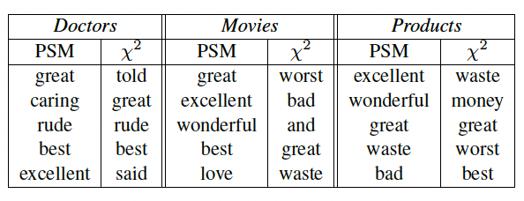
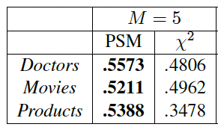
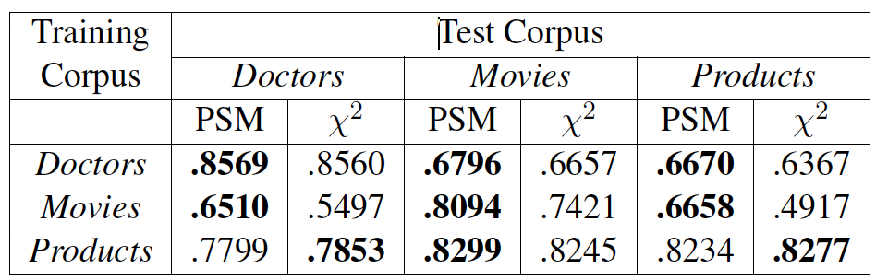
Results
F1-scores of sentiment classifiers are calculated for various feature sets, and the area under these curves (AUC) is computed to compare the performance of a classifier
Logical analysis
M: number of features
1.
2.
In purple: no obvious meaning
Better out-of-domain performance
Less features, better performance =
meaningful feature discovery
Notes:
May be effective in identifyin features that can be applied across domains

Slide 11
(Most important) Results
Generalizability: PSM outperforms χ² when testing on out-of-domain data. This suggests that PSM may be particularly effective at identifying features that can generalize across different domains.
Top feature discovery: In a small number (M) of features, PSM seems to have strong sentiment associations compared to baseline

Slide 12
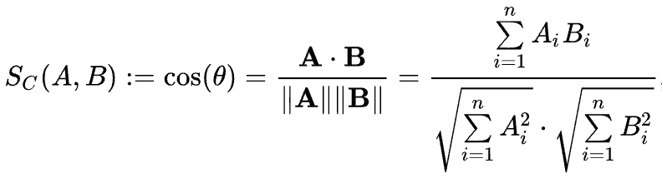
Future Work
Major drawback: slow
Explore scalable alternatives to logistic regression for defining propensity scores, e.g cosine similarity

Slide 13
Conclusion
Introduced propensity score matching for document classification
Matched documents with similar word propensity simulate RCT to discover causal associations
May lead to generalizable features - PSM performed better on out-of-domain data
Better at discovering top word features
Future work to explore other metrics to improve efficiency

Slide 14

Thank you for listening :-)

Slide 15
Experimental Design
Three domains: Doctors, Movies, and Products. Each dataset involves reviews, and class labels are assigned based on rating scales specific to each domain.
Less frequent words appearing in less than 0.5% of each corpus are pruned.
Experimental details involve randomly splitting each corpus into training (50%), development (25%), and testing (25%) sets.
Two hyperparameters for PSM are tuned: regularization strength during propensity score estimation and the allowed difference between scores for matching.
Logistic regression classifiers are employed for sentiment classification
The PSM method is compared to a standard chi-squared test for feature selection
The analysis involves a grid search over hyperparameters, and scikit-learn is employed for implementation.
The baseline comparison aims to evaluate the efficacy of PSM against a widely used statistical test for feature selection in document classification.

Slide 16
Hyperparameter Settings
An investigation into different hyperparameter settings is conducted:
Regularization: Various values of the inverse regularization parameter ( ) are experimented with. High values generally result in worse scores, while small values lead to more consistent results. A value of =1.0 is recommended based on its high median score, competitive maximum score, and low variance.
Matching Threshold: Different thresholds for matching scores ( ) are explored. Scores consistently increase as increases. The experiment compares various thresholds, including 0.2, 0.8, 2.0, and 1. The results suggest that higher thresholds generally lead to better performance.
Coupling: The interaction between regularization and matching threshold is considered. Lower thresholds work better with heavier regularization, and vice versa. It is advised not to use =1 when =1.0. The best combinations of hyperparameters are ( = 100.0, = 1) and ( = 1.0, = 2.0). The latter is recommended due to its higher median and lower variance.
Figures 2 and 3 provide visual summaries of the distribution of scores with different hyperparameter settings.
These analyses offer insights into the behavior of PSM, highlighting the importance of hyperparameter tuning and the interplay between regularization and matching threshold.
P-Values
In this section, the examination of p-values generated by McNemar's test on propensity score matched data is compared to the standard chi-squared test. The distribution of the logarithm of p-values from both methods, using the same hyperparameters as in Section 4.3, is illustrated in Figure 4. Key findings include:
Distribution Discrepancy: The distribution of p-values from the standard chi-squared test ( 2) tends to have more extreme and lower values compared to propensity score matching.
Conservative Estimates: Propensity score matching yields more conservative estimates of the statistical significance of features. This indicates that PSM may be less prone to assigning overly significant p-values, suggesting a cautious approach to feature selection.
This analysis contributes to understanding the statistical behavior of PSM and emphasizes its potential for providing robust and reliable estimates of feature significance in comparison to traditional chi-squared tests.

Slide 17
Previous work 2
Matching Techniques in Text Training Data Improvement
Tan et al. (2014): Used matching techniques to estimate the number of retweets for Twitter messages, addressing confounding factors by matching tweets with the same author and topic.
Zhang et al. (2016): Applied matching sampling to predict media coverage of journal articles, selecting negative training examples by choosing articles from the same journal issue.
Contrastive Estimation (Smith and Eisner, 2005): Although different in motivation, contrastive estimation involves synthesizing negative training examples by perturbing positive instances, effectively matching instances with the same semantics but different syntax.
Annotation plays a crucial role in understanding feature importance. Some branches of active learning (Raghavan et al., 2006; Druck et al., 2009) involve annotators labeling not only documents but also features for importance or relevance.
Work on annotator rationales (Zaidan et al., 2007; Zaidan and Eisner, 2008) explores modeling why annotators label a document in a certain way, aiming to identify what "caused" the document to receive its label. Integration of these ideas with causal inference methods for document classification could be a promising avenue for future exploration.

